Slide 1




Geostatistical Analysis of Violent Crime in Atlanta
Presented by: Sam Shuster

Slide 2




Background:
Home to fortune 500 company headquarters from companies like:
Atlanta’s Population is estimated to be approximately 488,800
(According to the 2019 American Community Survey: 5-Year Dataset)

Slide 3
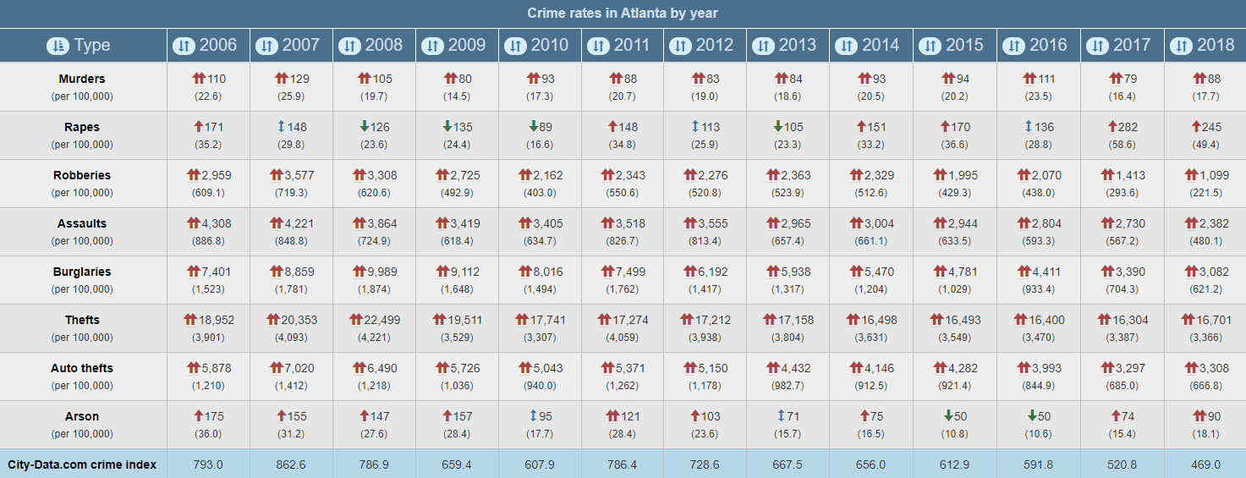
Success in Law Enforcement:
In the last ~15 years, crime has decreased approximately 40%

Slide 4
Objectives:
Evaluate crime data to explore potential spatial relationships
Determine whether there is any correlation between location and violent crimes like robbery and rape
Determine whether there are any factors that increase the likelihood of criminality
Roughly determine the safest and most dangerous regions to live within the city

Slide 5
Methodology:
Conducted Hot Spot Analysis using Getis-Ord Gi in ArcGIS
Conducted OLS for Robbery and Rape in ArcGIS
Conducted OLS test in GeoDa
Conducted Spatial Lag test in GeoDa
Conducted Geographically Weighted Regression in ArcGIS
Spatial resolution for all tests was conducted at the Census Block level

Slide 6
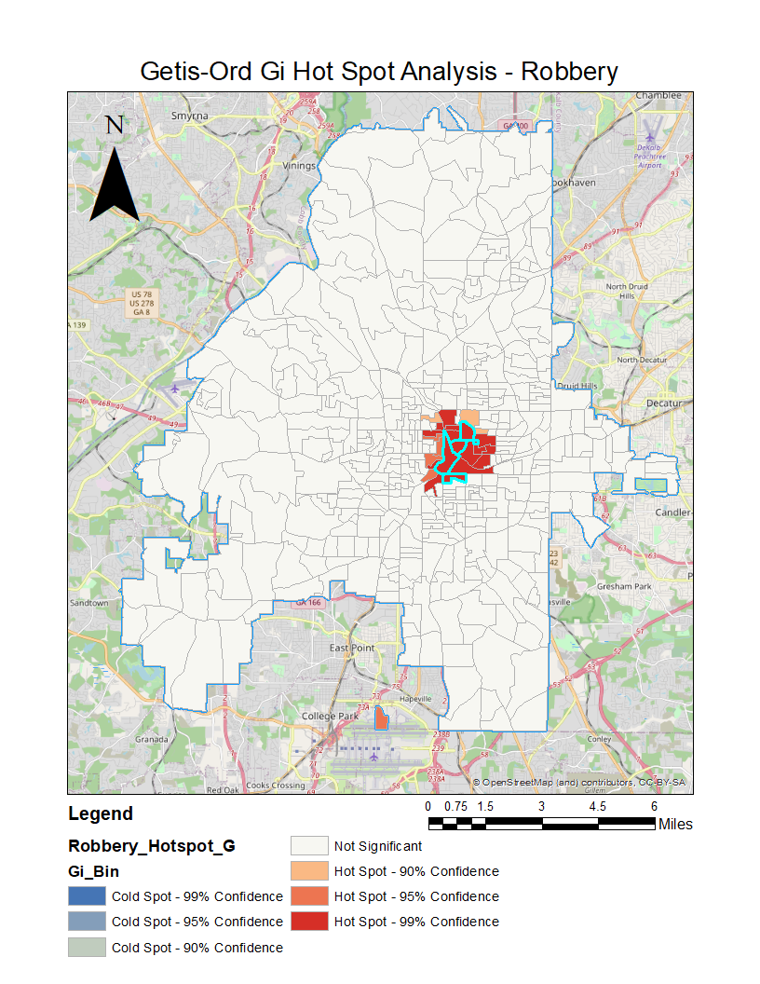
Location Analysis:
Using Getis-Ord, a Hot Spot region was found bounded by GA Tech to the north, & I-20 to the South, US-19 to the West, and Jackson Street (SE) to the East.
Queen continuity SWM used.

Slide 7
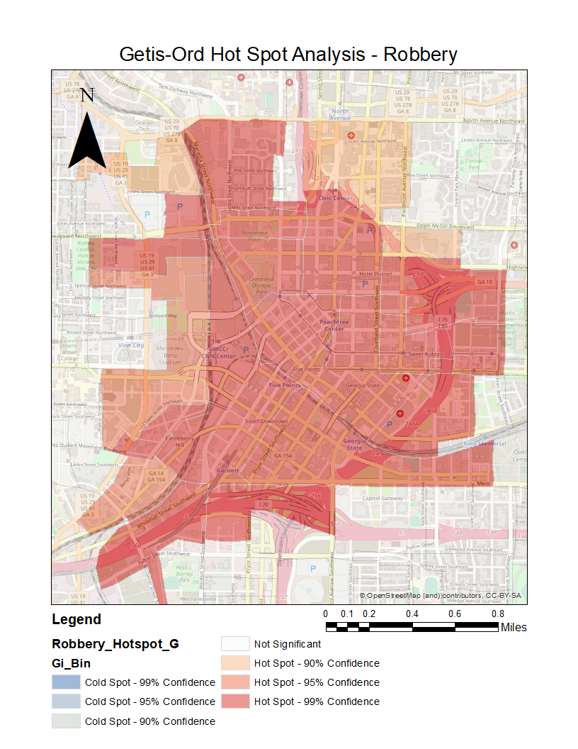
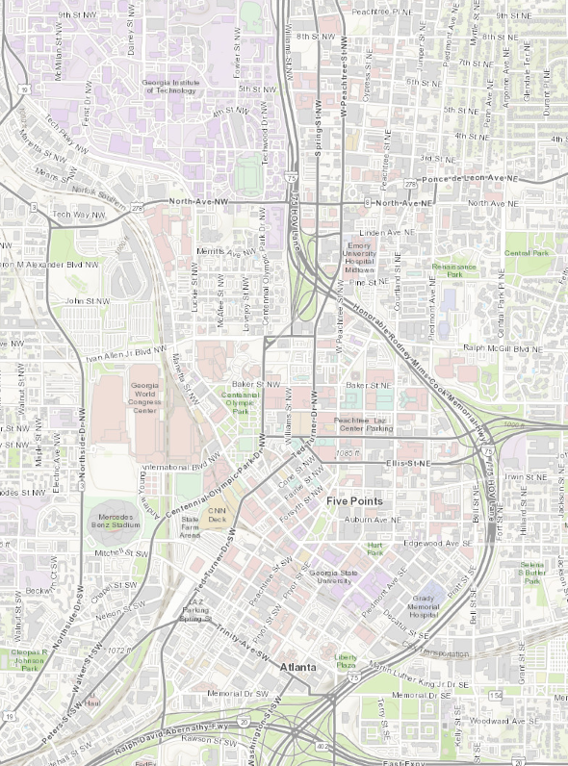






Slide 8
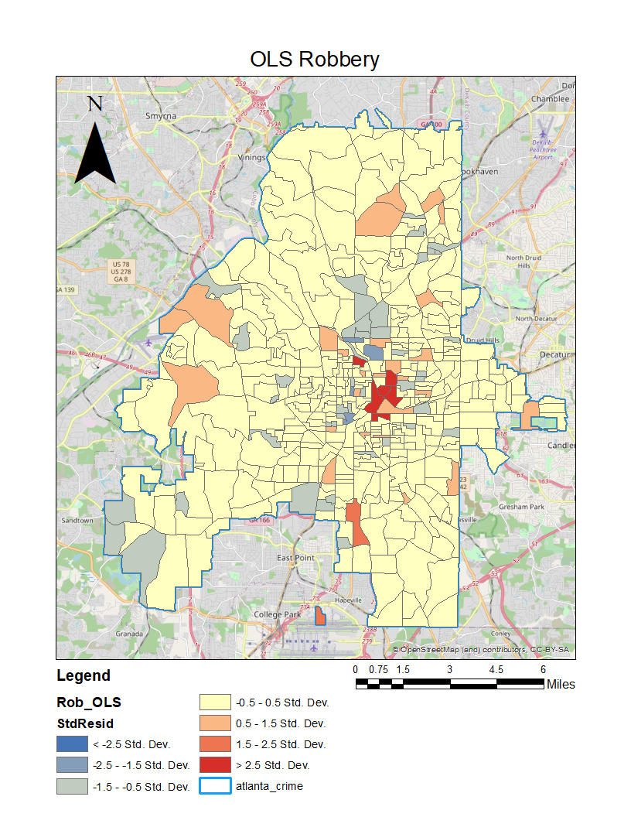
OLS Robbery
Evaluated robbery based on:
White (cnt)
Black (cnt)
Hispanic (cnt)
Other Races (cnt)
Housing Units (cnt)
Vacant Housing Units (cnt)
Median Family Income ($)
Median Home Value ($)
1 Adult Households (%)
1 Parent Households (%)
Fulltime Employment (%)
HS Education (%)
Poverty (%)
Unemployment (%)
Ages 15-24 (%)

Slide 9

Initial Findings (OLS Robbery):
Significant factors:
White (cnt)
Black (cnt)
Hispanic (cnt)
Other Races (cnt)
Housing Units (cnt)
Vacant Housing Units (cnt)
Median Family Income ($)
Median Home Value ($)
1 Adult Households (%)
1 Parent Households (%)
Fulltime Employment (%)
HS Education (%)
Poverty (%)
Unemployment (%)
Ages 15-24 (%)
Poverty is the most influential factor contributing to elevated robbery rates.
Elevated Risk Factors:
Low Median Family Income (MFI)
Low Median Home Value (MHV)
High numbers of single Parent HH’s
Areas w/ high numbers of teens – a large portion of robberies are committed by those in their late teens.

Slide 10
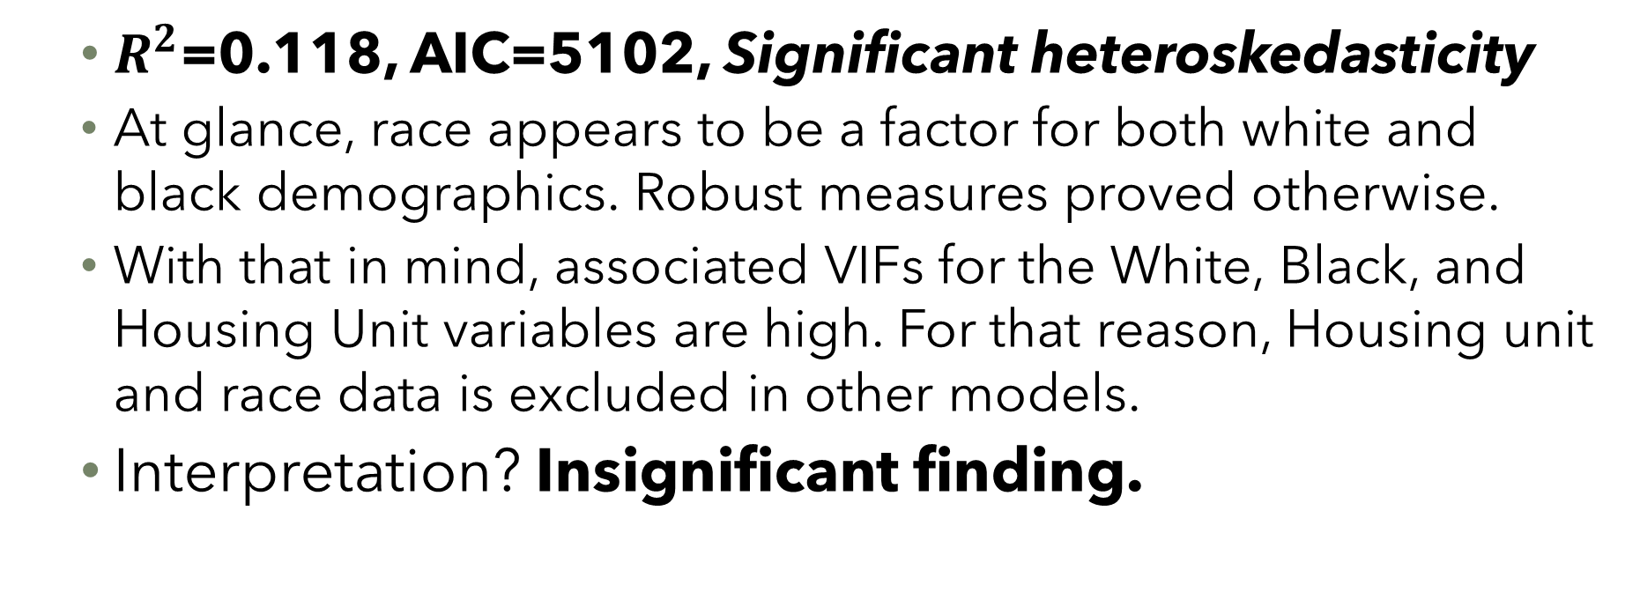
Initial Findings (OLS) cont.
Assessment of model fitness:
$R^{2}$=0.118, AIC=5102, Significant heteroskedasticity
At glance, race appears to be a factor for both white and black demographics. Robust measures proved otherwise.
With that in mind, associated VIFs for the White, Black, and Housing Unit variables are high. For that reason, Housing unit and race data is excluded in other models.
Interpretation? Insignificant finding.

Slide 11

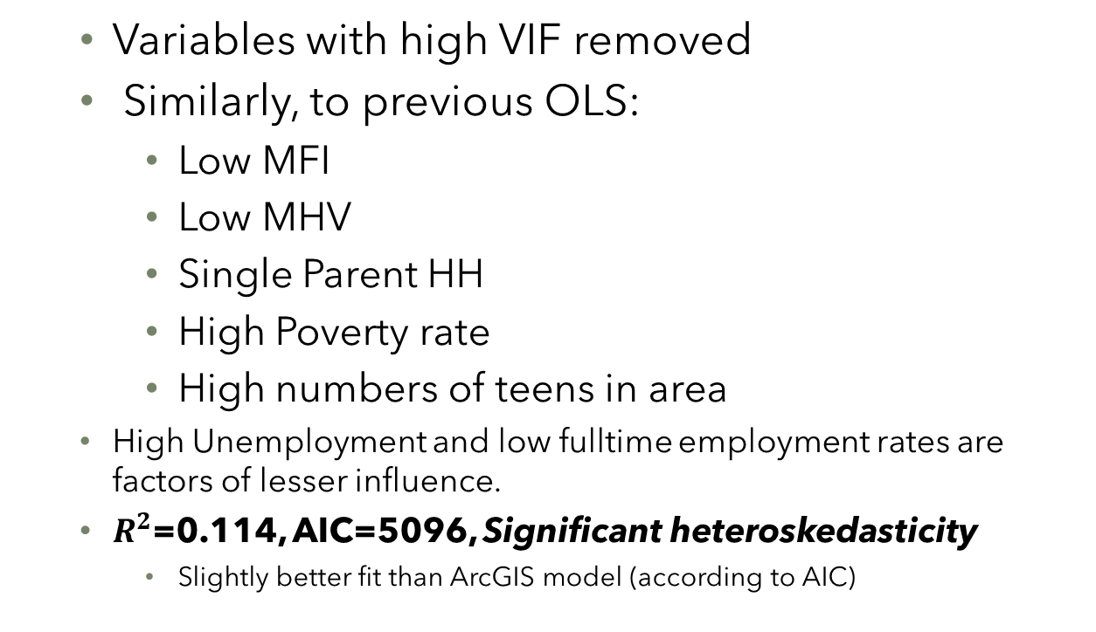
Findings (OLS Robbery) GeoDa:
Significant Factors:
Median Family Income ($)
Median Home Value ($)
1 Adult Households (%)
1 Parent Households (%)
Fulltime Employment (%)
HS Education (%)
Poverty (%)
Unemployment (%)
Ages 15-24 (%)
Population 1990 (cnt)
Variables with high VIF removed
Similarly, to previous OLS:
Low MFI
Low MHV
Single Parent HH
High Poverty rate
High numbers of teens in area
High Unemployment and low fulltime employment rates are factors of lesser influence.
$R^{2}$=0.114, AIC=5096, Significant heteroskedasticity
Slightly better fit than ArcGIS model (according to AIC)

Slide 12
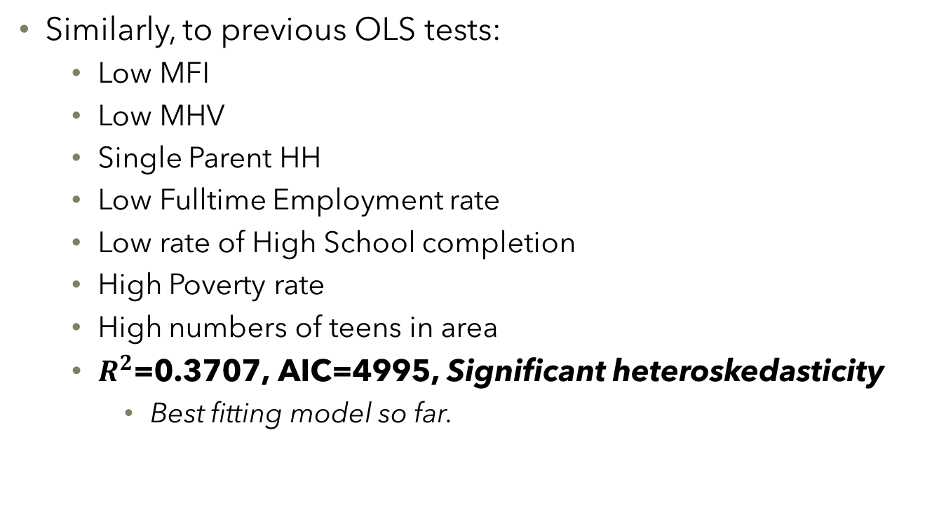
Findings (Spatial Lag) GeoDa:
Significant Contributing Factors:
Median Family Income ($)
Median Home Value ($)
1 Adult Households (%)
1 Parent Households (%)
Fulltime Employment (%)
HS Education (%)
Poverty (%)
Unemployment (%)
Ages 15-24 (%)
Population 1990 (cnt)
Similarly, to previous OLS tests:
Low MFI
Low MHV
Single Parent HH
Low Fulltime Employment rate
Low rate of High School completion
High Poverty rate
High numbers of teens in area
$R^{2}$=0.3707, AIC=4995, Significant heteroskedasticity
Best fitting model so far.

Slide 13
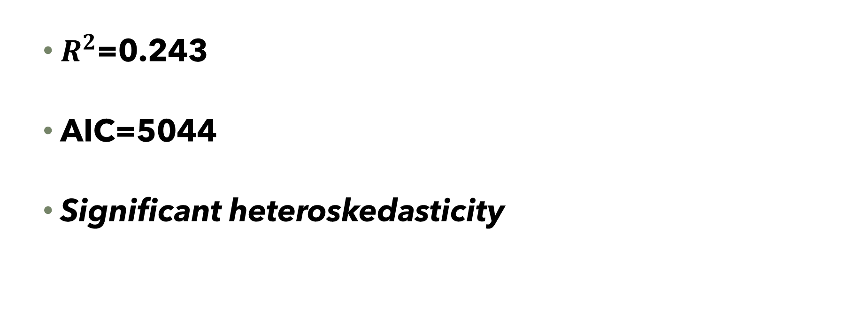
Findings (GWR Robbery):
Assessment of model fitness:
$R^{2}$=0.243
AIC=5044
Significant heteroskedasticity

Slide 14
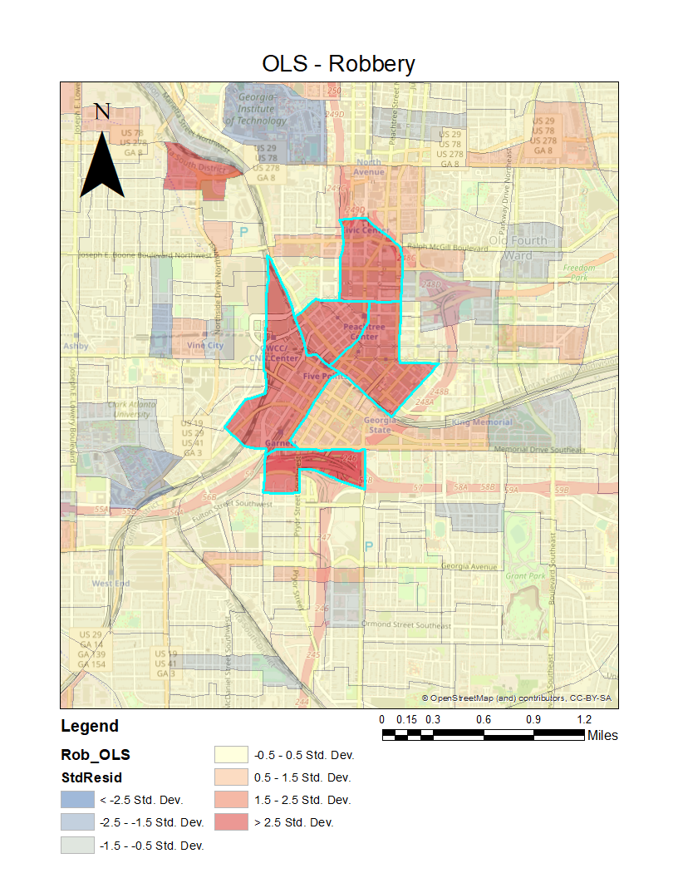
Location Analysis (Robbery):
The highest concentration of robberies appears to occur in the heart of the city – roughly spanning the area from spaghetti Junction to the South, Georgia State to the East and Centennial Olympic Park to the Northwest.

Slide 15
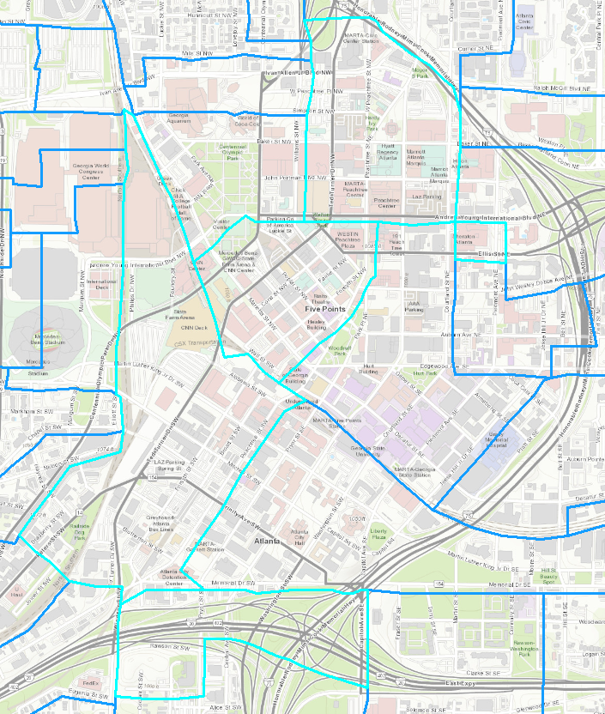

Location Analysis:
The highest concentration of robberies appears to occur in the heart of the city – roughly spanning the area from spaghetti Junction to the South, Georgia State to the East and Centennial Olympic Park to the Northwest.

Slide 16
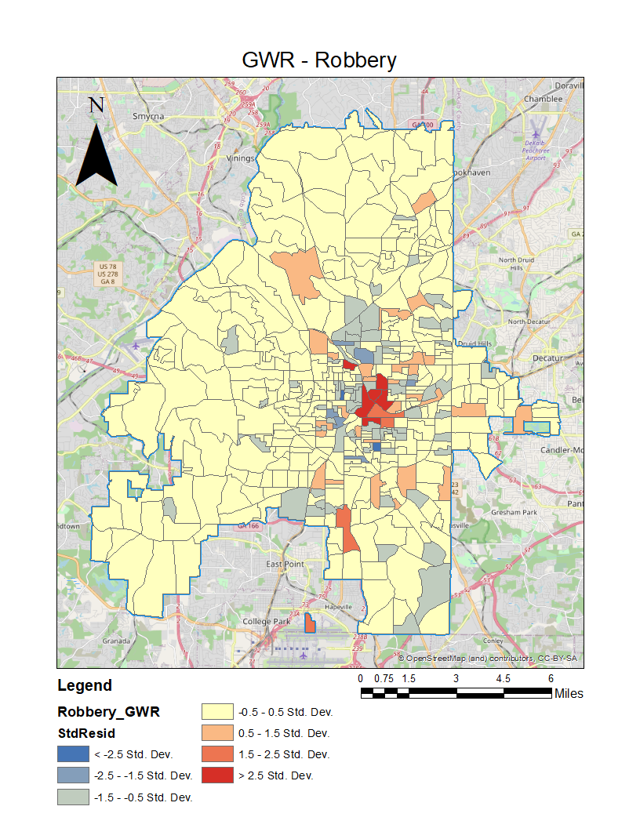
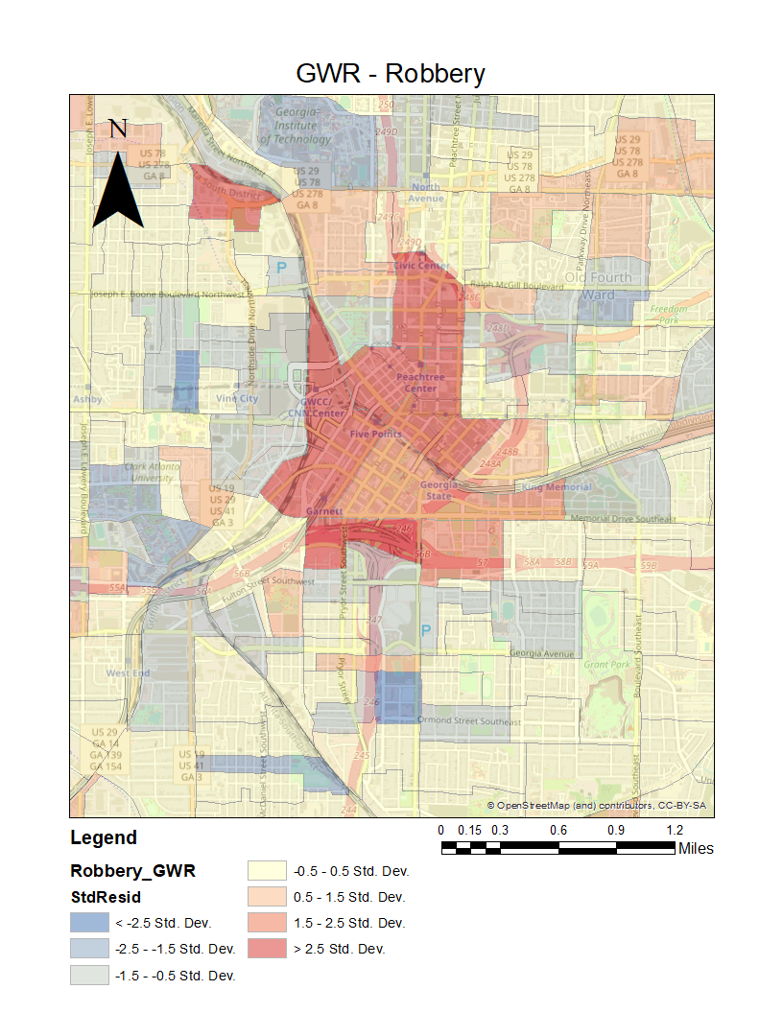
Location Analysis:
The highest concentration of robberies appears to occur in the heart of the city – roughly spanning the area from spaghetti Junction to the South, Georgia State to the East and Centennial Olympic Park to the Northwest.

Slide 17
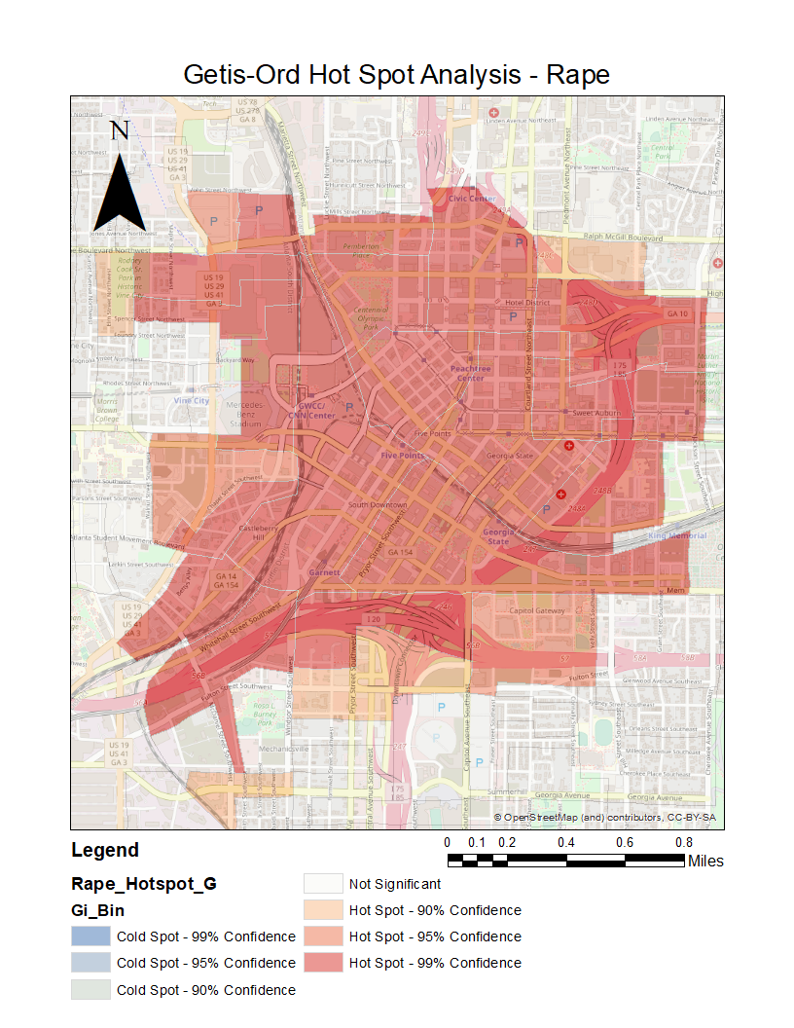
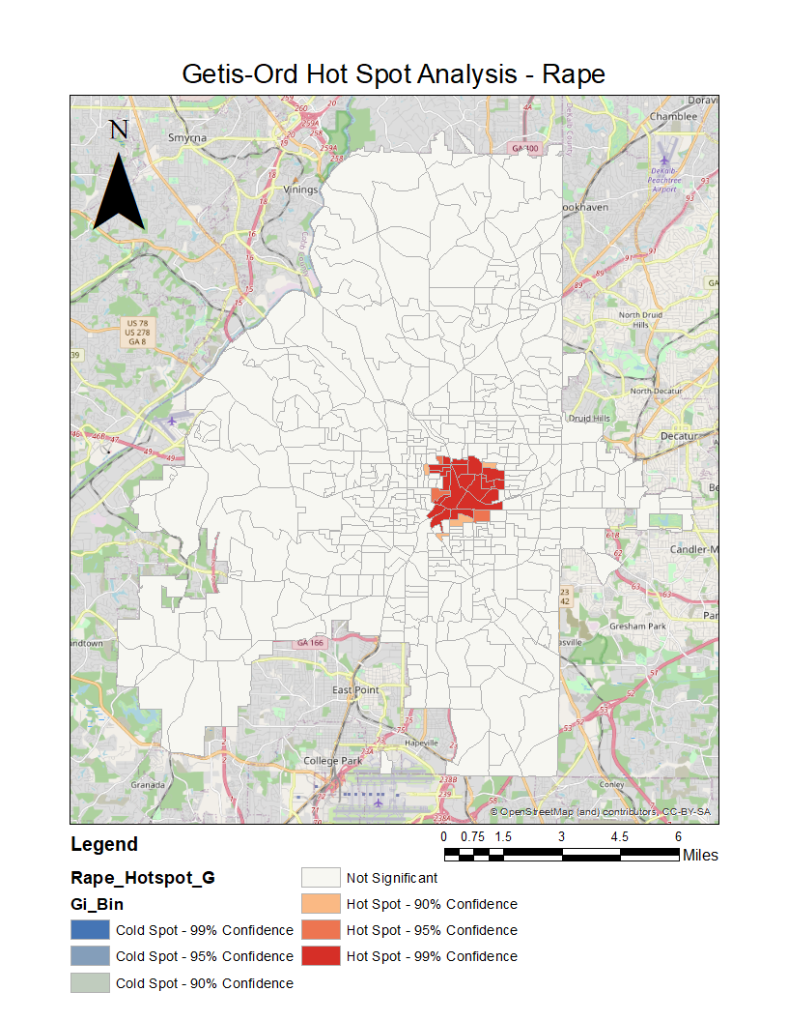
Location Analysis (Rape):
Using Getis-Ord, a Hot Spot region was found bounded by GA Tech to the north, Spaghetti JCTN & I-20 to the South, US-19 to the West, and Jackson Street (SE) to the East.
Queen continuity SWM used.

Slide 18
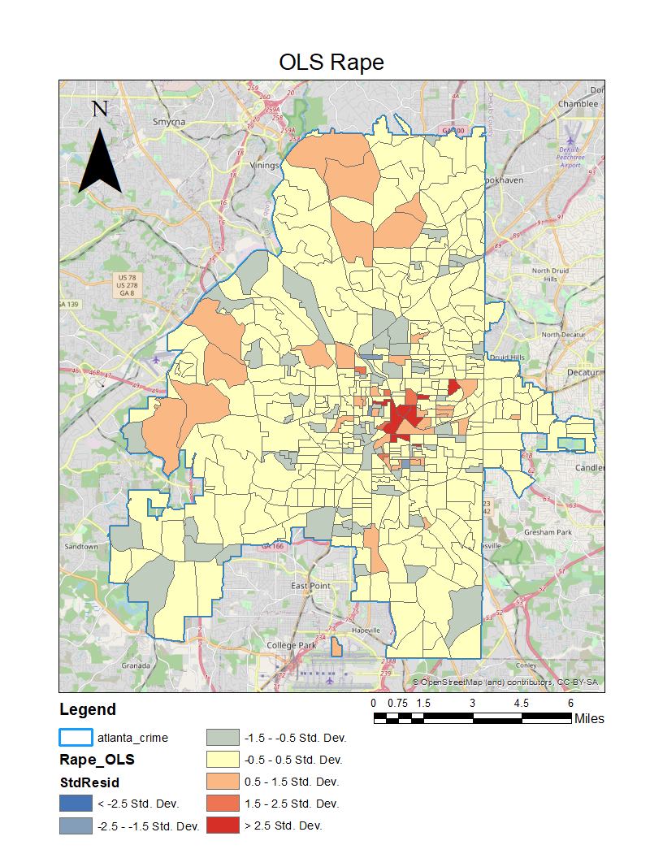
OLS Rape
Evaluated rape based on:
White (cnt)
Black (cnt)
Hispanic (cnt)
Other Races (cnt)
Housing Units (cnt)
Vacant Housing Units (cnt)
Median Family Income ($)
Median Home Value ($)
1 Adult Households (%)
1 Parent Households (%)
Fulltime Employment (%)
HS Education (%)
Poverty (%)
Unemployment (%)
Ages 15-24 (%)

Slide 19
Initial Findings (OLS Rape):
Significant factors:
White (cnt)
Black (cnt)
Hispanic (cnt)
Other Races (cnt)
Housing Units (cnt)
Vacant Housing Units (cnt)
Median Family Income ($)
Median Home Value ($)
1 Adult Households (%)
1 Parent Households (%)
Fulltime Employment (%)
HS Education (%)
Poverty (%)
Unemployment (%)
Ages 15-24 (%)
The most influential factor in analysis of rape rates appears to be related to education.
Areas with low High School completion rates have higher rates of rape.
Other elevated risk factors include:
Low Median Home Value (MHV)
High numbers of single Parent HH’s
High Poverty rates
Areas w/ high numbers of teens – statutory rape is included in rape rate.
The Black community appears to have a significantly higher rate of rape than other races

Slide 20
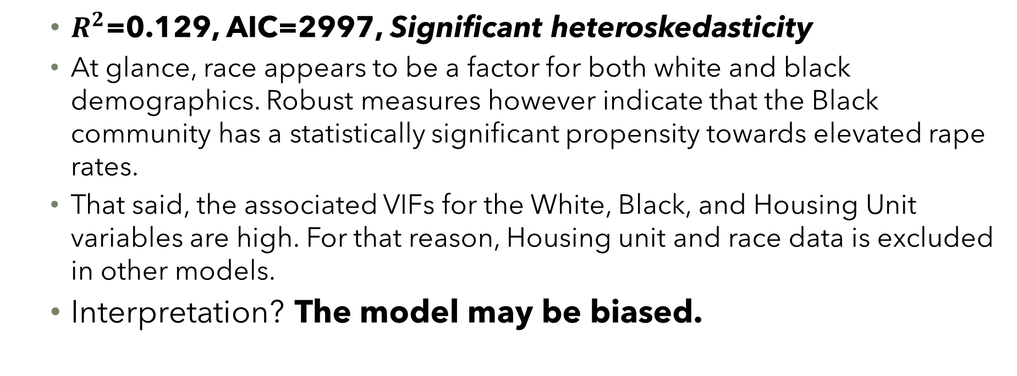
Initial Findings (OLS) cont.
Assessment of model fitness:
$R^{2}$=0.129, AIC=2997, Significant heteroskedasticity
At glance, race appears to be a factor for both white and black demographics. Robust measures however indicate that the Black community has a statistically significant propensity towards elevated rape rates.
That said, the associated VIFs for the White, Black, and Housing Unit variables are high. For that reason, Housing unit and race data is excluded in other models.
Interpretation? The model may be biased.

Slide 21
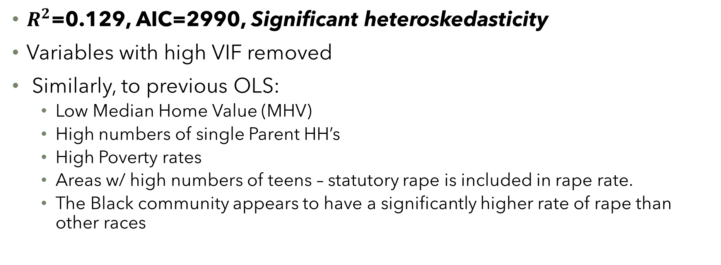
Findings (OLS Rape) GeoDa:
Significant Factors:
$R^{2}$=0.129, AIC=2990, Significant heteroskedasticity
Variables with high VIF removed
Similarly, to previous OLS:
Low Median Home Value (MHV)
High numbers of single Parent HH’s
High Poverty rates
Areas w/ high numbers of teens – statutory rape is included in rape rate.
The Black community appears to have a significantly higher rate of rape than other races

Slide 22
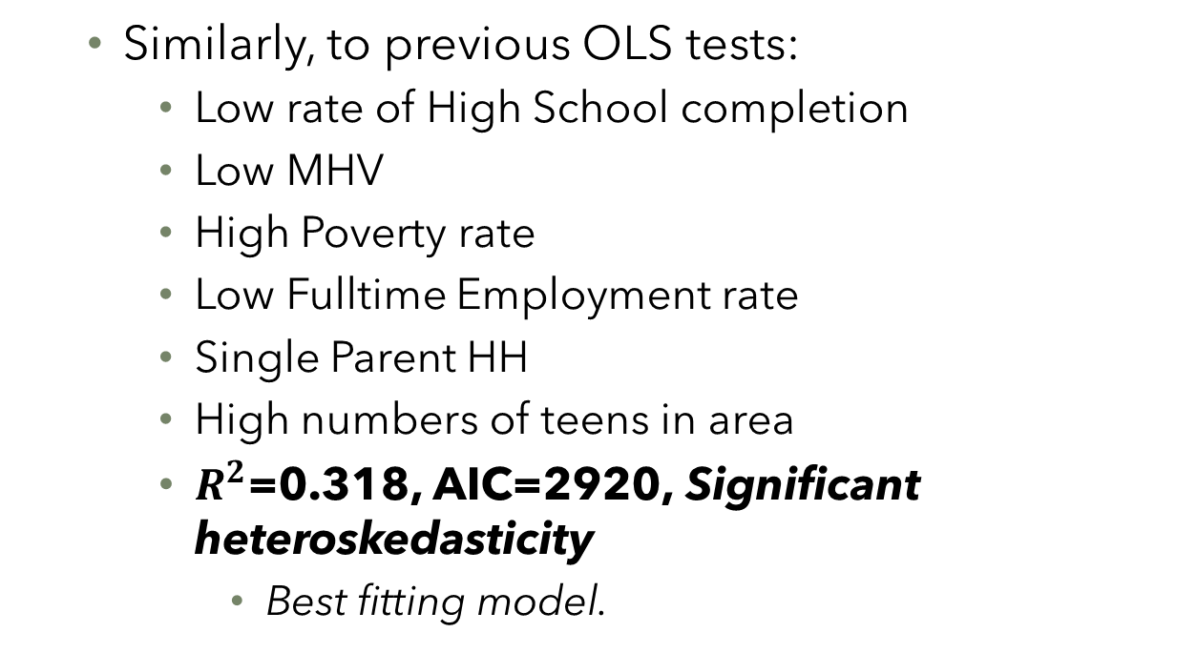
Findings (Spatial Lag) GeoDa:
Significant Contributing Factors:
Median Family Income ($)
Median Home Value ($)
1 Adult Households (%)
1 Parent Households (%)
Fulltime Employment (%)
HS Education (%)
Poverty (%)
Unemployment (%)
Ages 15-24 (%)
Population 1990 (cnt)
Similarly, to previous OLS tests:
Low rate of High School completion
Low MHV
High Poverty rate
Low Fulltime Employment rate
Single Parent HH
High numbers of teens in area
$R^{2}$=0.318, AIC=2920, Significant heteroskedasticity
Best fitting model.

Slide 23

Findings (GWR Rape):
Assessment of model fitness:
$R^{2}$=0.153
AIC=2989
Significant heteroskedasticity

Slide 24
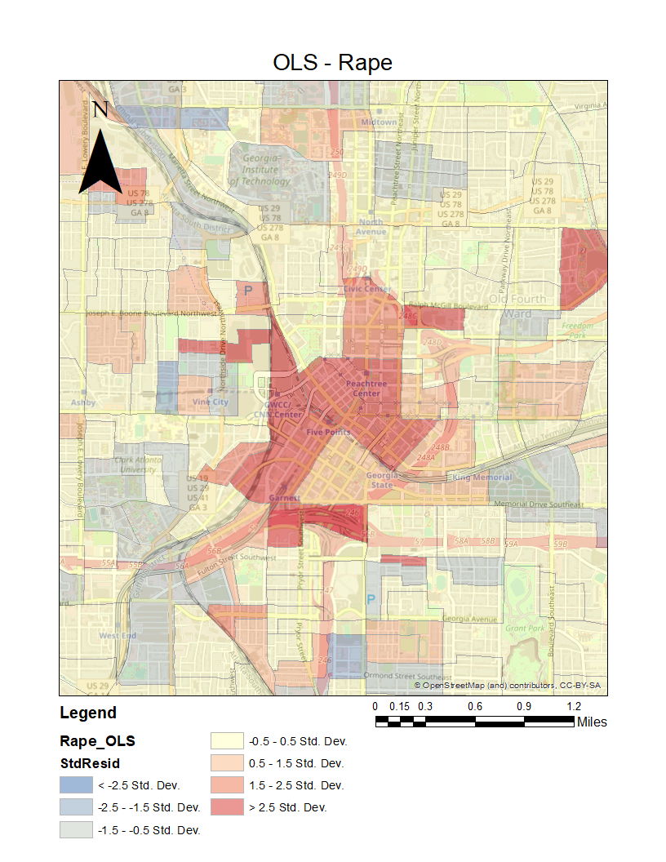
Location Analysis:
The highest concentration of rapes appears to occur in the heart of the city – roughly spanning the area from spaghetti Junction to the South, Georgia State to the East and Centennial Olympic Park to the Northwest.

Slide 25

Location Analysis:
The highest concentration of rapes appears to occur in the heart of the city – roughly spanning the area from spaghetti Junction to the South, Georgia State to the East and Centennial Olympic Park to the Northwest.

Slide 26
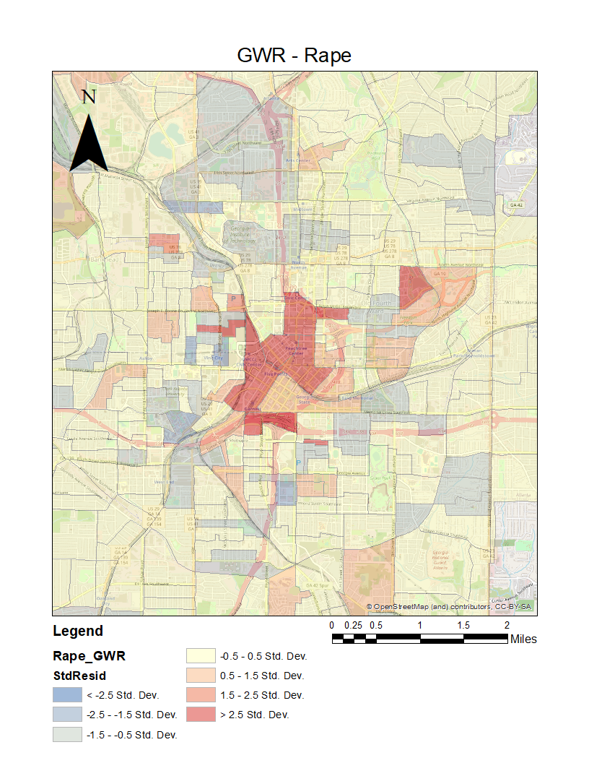
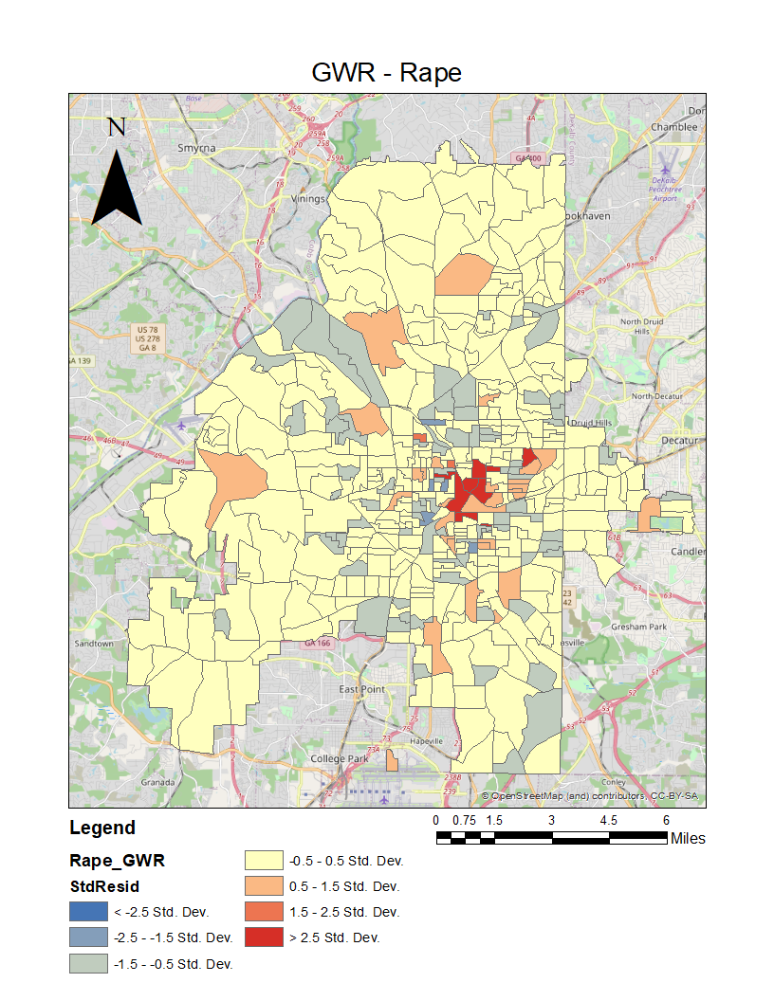
Location Analysis:
The highest concentration of rapes appears to occur in the heart of the city – roughly spanning the area from spaghetti Junction to the South, Georgia State to the East and Centennial Olympic Park to the Northwest.

Slide 27
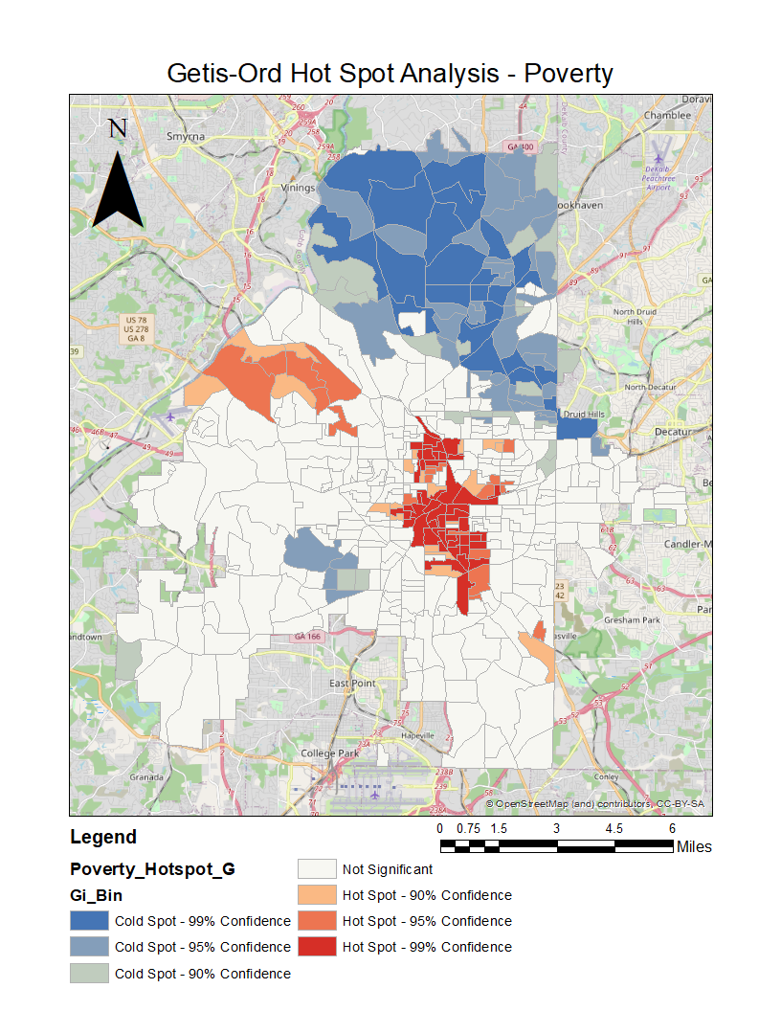
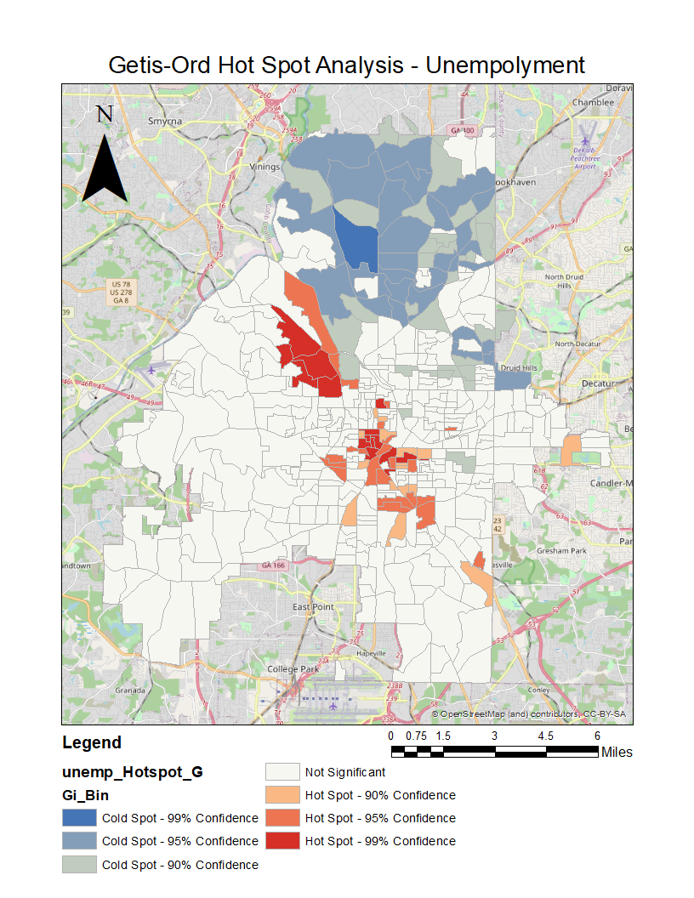

Slide 28
Conclusions:
Poverty is a primary driver for robbery.
Low-income communities with high numbers of single parent HHs are at high risk for violent crime.
Lack of education is the best indicator for predicting rape.
Northern part of the city is the safest; the central portion is the most dangerous.
The Spatial lag models were the best fits for both Robbery & Rape.
Model heteroskedasticity indicates further analysis must be conducted.

Slide 29
Resources:
NHGIS
Atlanta Police Department
City-Data.com
GeoDa
ArcGIS

Slide 30
Questions?

